Slide 1
HE3613/ HE3026 Urban Economics
Factors affecting HDB Resale Prices in Singapore
SANKAR SAMIKSHA (U2021021D)
DAVID MICHELLE KATE MENDOZA (U2030427E)
NUR AQIDAH BINTE AZHARI (U2130553F)
YONG JIAN RONG (U1921139F)

Slide 2
Contents
01
Introduction
Theory
02
03
Data Collection
04
Econometrics Model
Results
05
Conclusion
06

Slide 3
Introduction Hedonic Pricing Model
40%
42.2%
rise in the median price of 5-room HDB resale flats in Chua Chu Kang
Increase in the median price of 3-room HDB resale flat
90.1%
Ownership rate
nationwide

Slide 4
Assumptions
A1
A2
A3
A4
Workers in CBD prefer to live near it
Linearly proportional
Houses are equally furnished
Buyers bear full costs
(No subsidy)

Slide 5
Research Question
How significant are housing factors, such as locational factors, in influencing the HDB resale prices
in Singapore?

Slide 6
Aim
To examine and compare the relative significance of housing factors on HDB resale market price
To analyse and account for possible anomalies in our results

Slide 7
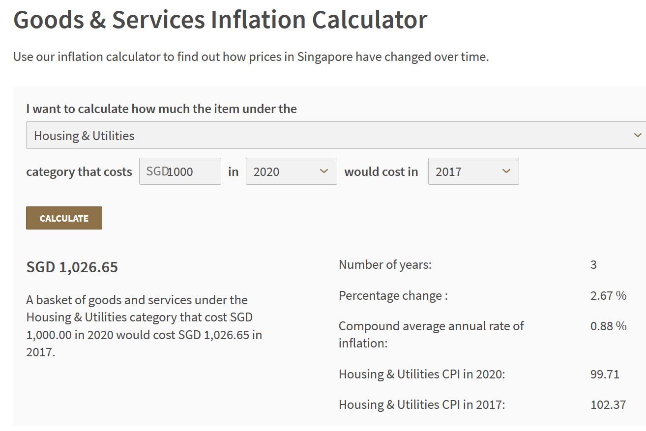
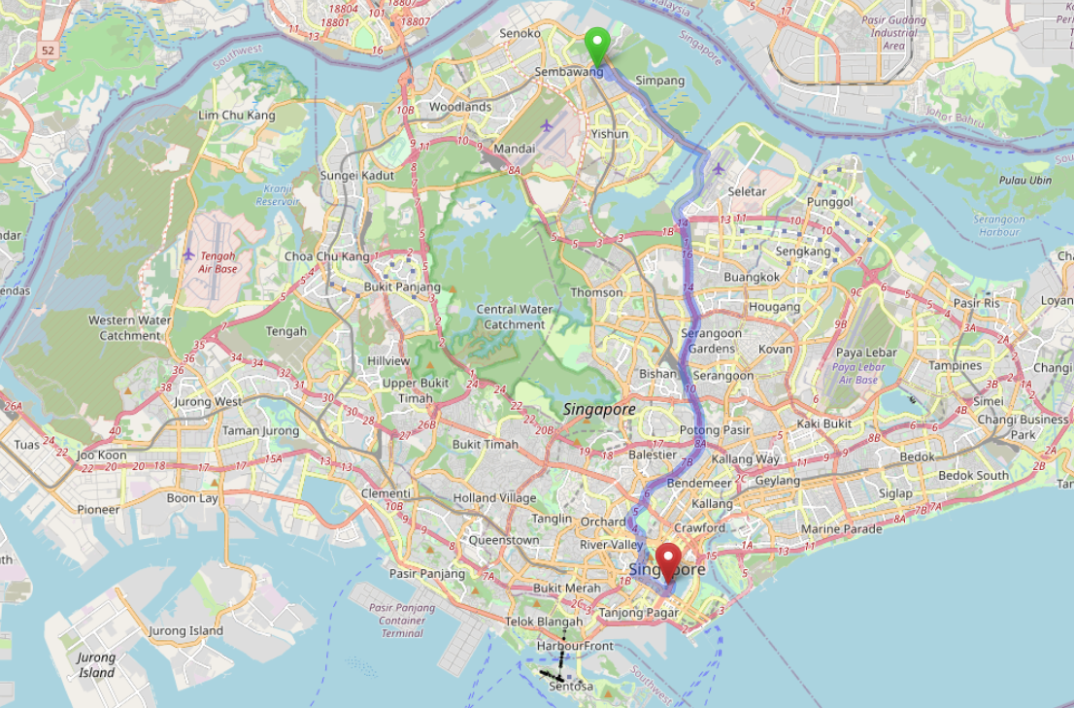
Data Collection
Data.gov.sg – Official government website for Singapore HDB Resale statistics
(Date Range: Jan 2017 to Sep 2020)
2. OpenStreetMaps API
Driving router function

Slide 8
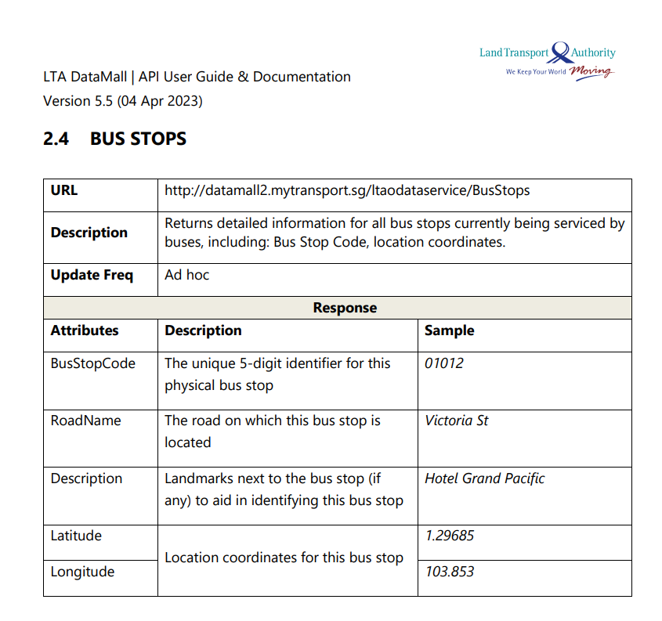
Data Collection
3. LTA Data Mall API – for coordinates of bus stops and calculation of number of bus stops in 200m radius

Slide 9
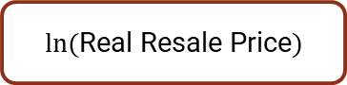

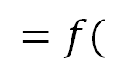
Y and X variables
$ln⁡($Real Resale Price$)$
$$=f($$
$$)$$
Accessibility factors, Size and height, Lease
Resale Price
Accessibility
Size and Height
Lease
Adjustment for inflation
Apply ln function
Number of Bus Stops
HDB to CBD Distance
HDB to nearest MRT distance
Floor area (m²)
Floor Height
Remaining lease (years)

Slide 10
1. Resale Price → ln(Real Resale Price)
Base Year = 2017
Adjust year 2020 nominal prices to 2017 levels
2.67% more in 2017
than 2020

Slide 11
2. Accessibility
‘HDB to nearest MRT’ distance – public transport accessibility
‘HDB to CBD’ distance – work/town area accessibility
Number of bus stops (within 200m) – transport accessibility

Slide 12
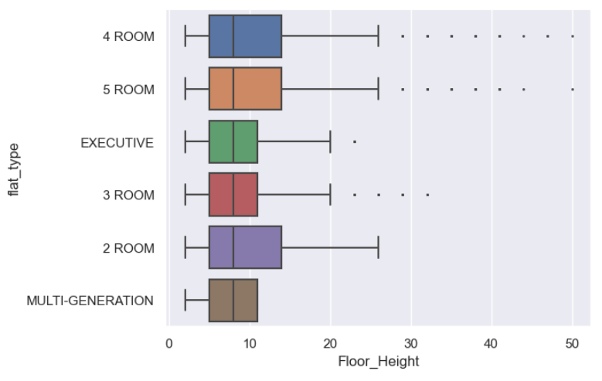
3. Size and Height
Room Types
2 to 5 rooms, Executive
Minority excluded: Multi-Generation flats
Floor Height
Original: ‘01 to 03’, …, ‘49 to 51’
Cleaned: Middle values of each group
(2, 5, 8 …, 47, 50)

Slide 13
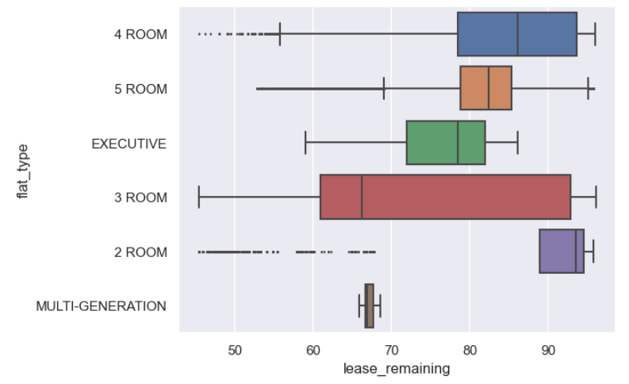
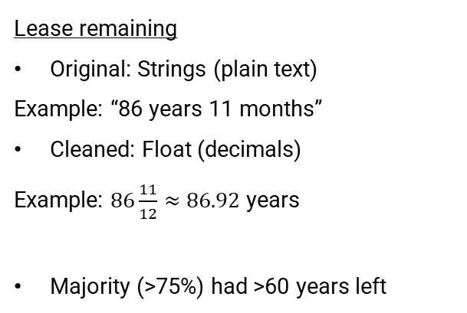
4. Lease Remaining
Lease remaining
Original: Strings (plain text)
Example: “86 years 11 months”
Cleaned: Float (decimals)
Example: $86\frac{11}{12}≈86.92$ years
Majority (>75%) had >60 years left

Slide 14
In theory based on previous research:
All other factors being constant:
Larger floor area → Higher price
If a HDB is nearer to MRT/nearer to CBD/have more nearby bus stops → Save on commuting time and cost → Higher price
Greater floor height → less noise pollution, better views → Higher price
Longer lease remaining → more years of ownership → Higher price

Slide 15
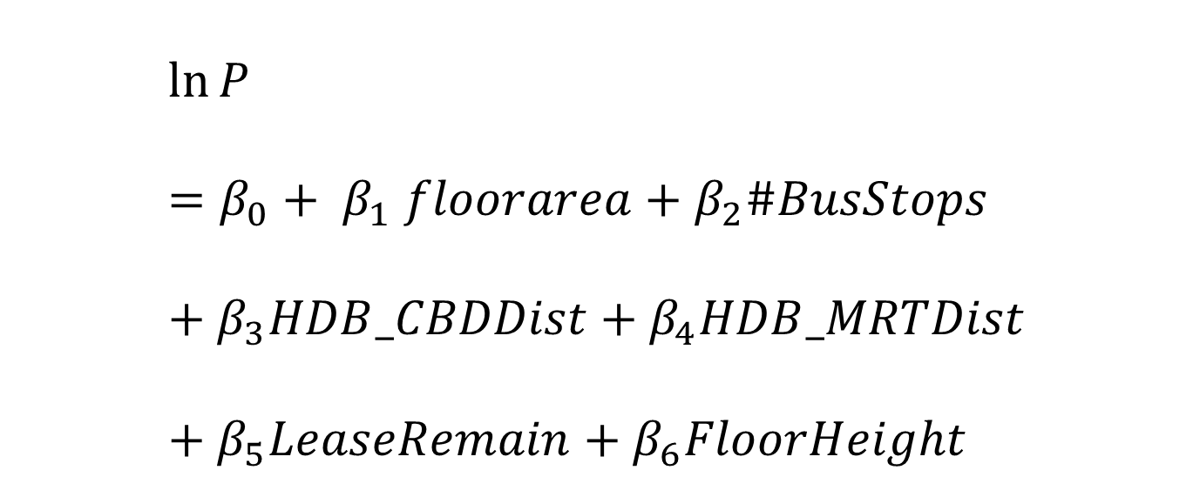
Econometric Model
$$\ln{P}=β_{0}+ β_{1} floorarea+β_{2}\#BusStops+β_{3}HDB_CBDDist+β_{4}HDB_MRTDist+β_{5}LeaseRemain+β_{6}FloorHeight$$

Slide 16
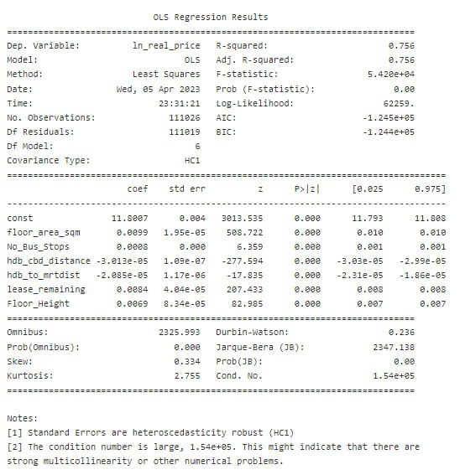
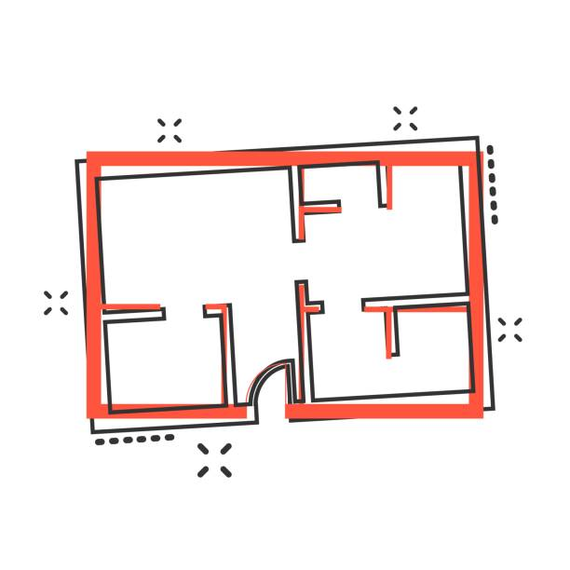
Overall OLS Results
Floor Area
X variable: Floor Area has a coefficient of 0.0099.
For every unit (1 m²) of floor area increment, the real price increases by approximately 0.99% on average, ceteris paribus.

Slide 17

Overall OLS Results
Number of Bus Stops
(Bus Accessibility)
X variable: Number of bus stops has a coefficient of 0.0008.
For every 1 more bus stop that is within close proximity of the HDB area, the real price increases by approximately 0.08% on average, ceteris paribus.

Slide 18

Overall OLS Results
Distance of HDB from CBD Area
X variable: HDB distance from CBD has a coefficient of -0.0000301.
This means a 3.01% price decrease for every additional kilometer from the CBD.
This aligns with the bid rent curve model where the greater the distance of the HDB from CBD, the lower the flat prices.

Slide 19

Overall OLS Results
Distance of HDB from MRT
X variable: HDB distance from MRT Stations has a coefficient of –0.0000208
This means a 2.08% price decrease for every additional kilometer from the MRT.
Owing to the high demand for better travel connectivity and minimise access time and its opportunity cost

Slide 20

Overall OLS Results
Lease Remaining
X variable: Lease Remaining has a coefficient of 0.0084.
With every additional year remaining in the lease, the HDB resale prices increase by 0.84% unit on average, ceteris paribus

Slide 21
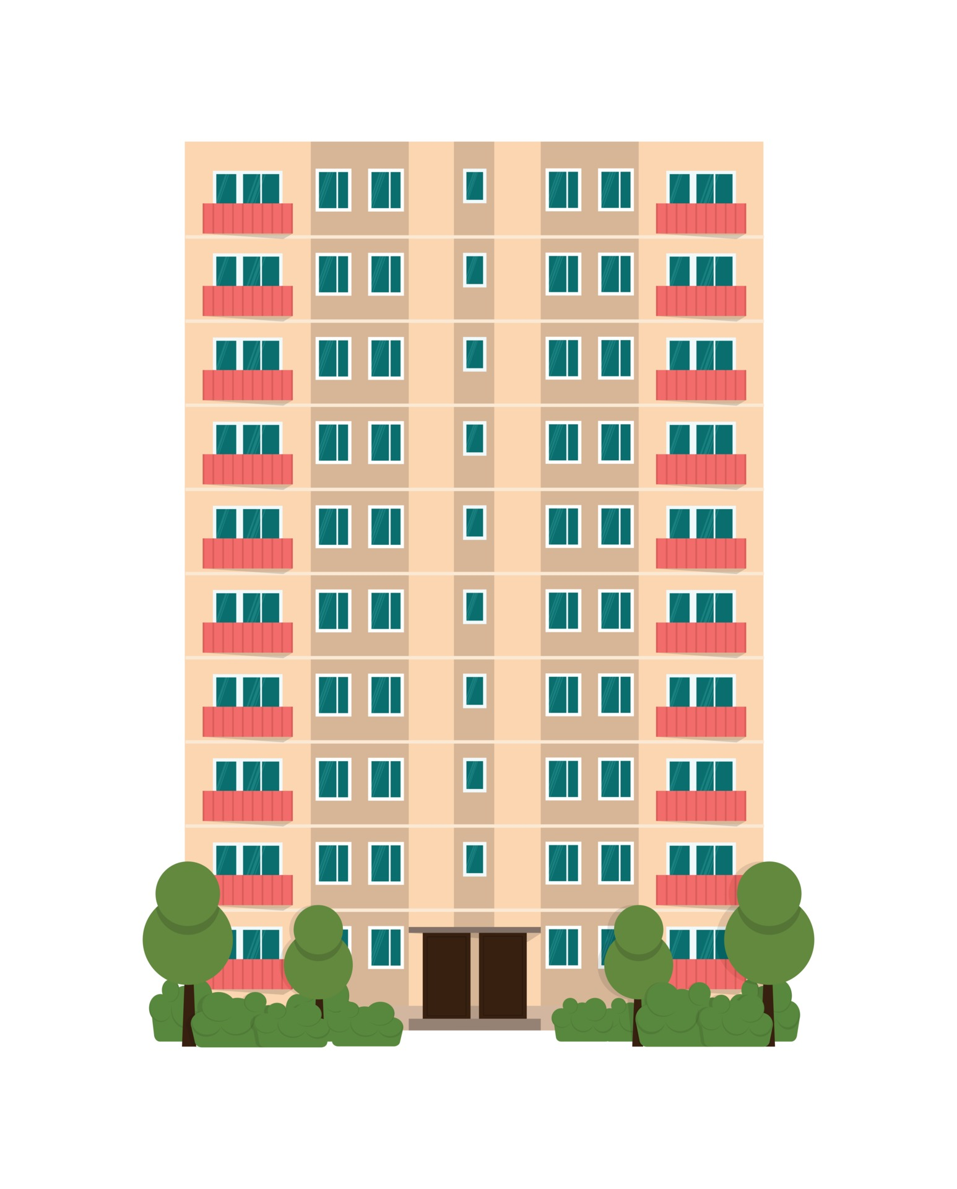
Overall OLS Results
Floor Height
X variable: Floor Height has a coefficient of 0.0069
With every unit increase in floor level, the HDB resale prices increase by 0.69% on average, ceteris paribus
Demand for a clearer and scenic view, less noise pollution or perception of better security at higher floors.

Slide 22
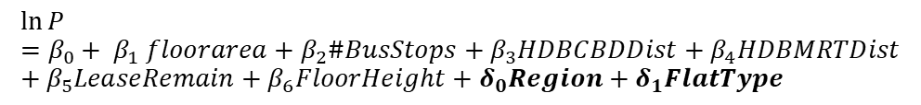
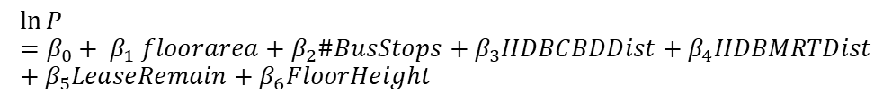
Other factors!
$$\ln{P}=β_{0}+ β_{1} floorarea+β_{2}\#BusStops+β_{3}HDBCBDDist+β_{4}HDBMRTDist+β_{5}LeaseRemain+β_{6}FloorHeight$$
$$\ln{P}=β_{0}+ β_{1} floorarea+β_{2}\#BusStops+β_{3}HDBCBDDist+β_{4}HDBMRTDist+β_{5}LeaseRemain+β_{6}FloorHeight+δ_{0}Region+δ_{1}FlatType$$
Region
Type
Central
West
East
North
North-East
2-room
3-room
4-room
5-room
Executive
Multi-generation

Slide 23
So how do we do it?
2 room
North
CLEANED DATASET
3 room
North-East
East
4 room
5 room
West
Central
Executive
Multi-generation

Slide 24
HDB CBD DISTANCE ANOMALY

Slide 25
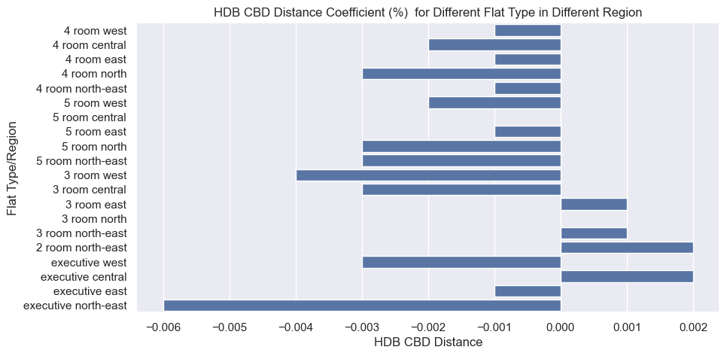

Slide 26
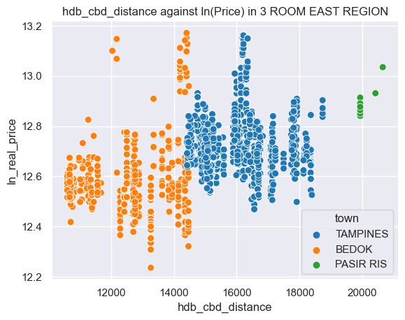
Lack of Data
Pasir Ris at the moment of data collection did not have many data points

Slide 27
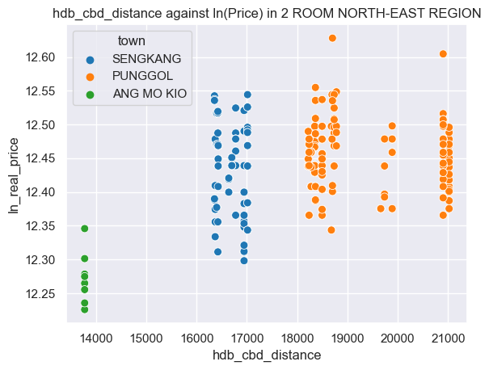
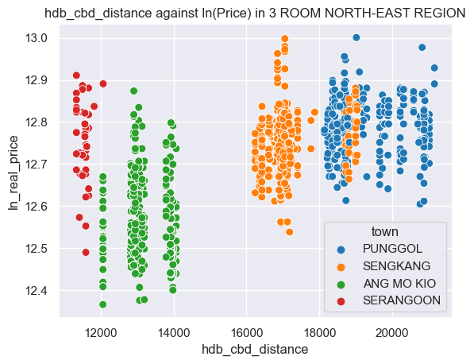
LRT Line Connectivity
Sengkang and Punggol have LRT Connections
Primary Schools and Young Estates
Sengkang and Punggol have more primary schools than Ang Mo Kio.
Average lease of Sengkang, Punggol and Ang Mo Kio are 94.02, 93.99, and 60.62

Slide 28
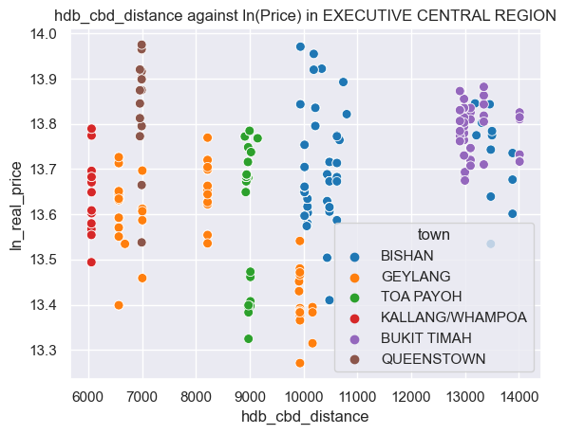
Prestigious Schools effect
Bishan: Catholic High School
Bukit Timah: Henry Park Primary School
Queenstown: Fairfield Methodist School (Primary)

Slide 29
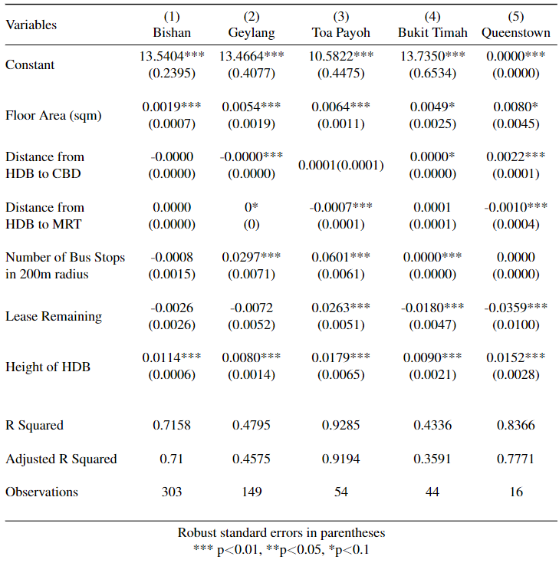
Prestigious schools effect

Slide 30
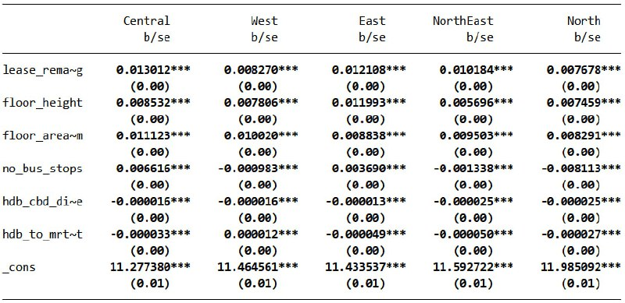
Distance from HDB to MRT Anomaly

Slide 31
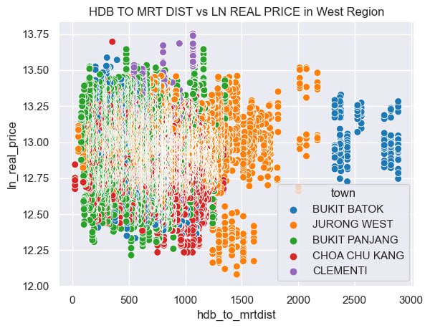
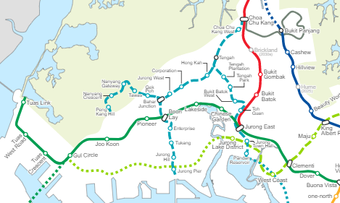
Distance from HDB to MRT
Theory: West is more interconnected by buses and thus may not value distance to the sparse MRT line as much.
As shown from the map, the Jurong region line is yet to be completed.

Slide 32
Number of Bus stops within 200m

Slide 33
Number of Bus stops within 200m: Theories
Does not fully reflect accessibility to bus routes
May not be a factor that homeowners consider when purchasing a house
May be an indicator of type of roads around the estate instead, could be a noise factor
Indicator of a remote area, no close amenities thus the need for buses
API used to collect bus stops were based on recent data, may not coincide with timeline of resale

Slide 34
Conclusion
Floor Area
Lease Remaining
Height of the HDB
Number of Bus Stops
Flat Type
Prestigious Schools
Region in Singapore
Distance From MRT/CBD

Slide 35
Thank you!

